Slide 1
Waste Management
By
- Dr. Anuradha Upadhyay

Slide 2
Waste
Waste (or wastes) are unwanted or unusable materials. Waste is any substance which is discarded after primary use, or is worthless, defective and of no use. A by-product by contrast is a joint product of relatively minor economic value.
A waste product may become a by-product, joint product or resource through an invention that raises a waste product's value above zero.

Slide 3
Types of Waste
Liquid Waste
Solid Rubbish
Plastic waste
Paper/card waste
Tins and metals
Ceramics and glass
Organic Waste
Recyclable Rubbish
Hazardous Waste

Slide 4
Liquid Waste
Liquid waste is commonly found both in households as well as in industries. This waste includes dirty water, organic liquids, wash water, waste detergents and even rainwater..

Slide 5
Solid Rubbish
Solid rubbish can include a variety of items found in your household along with commercial and industrial locations. Solid rubbish is commonly broken down into the following types:
Plastic waste
This consists of bags, containers, jars, bottles and many other products that can be found in your household. Plastic is not biodegradable, but many types of plastic can be recycled. Plastic should not be mix in with your regular waste, it should be sorted and placed in your recycling bin.
Paper/card waste
This includes packaging materials, newspapers, cardboards and other products. Paper can easily be recycled and reused so make sure to place them in your recycling bin or take them to your closest Brisbane recycling depot.
Tins and metals
This can be found in various forms throughout your home. Most metals can be recycled. Consider taking these items to a scrap yard or your closest Brisbane recycling depot to dispose of this waste type properly.
Ceramics and glass
These items can easily be recycled. Look for special glass recycling bins and bottle banks to dispose them correctly.

Slide 6
Organic Waste
Organic waste is another common household. All food waste, garden waste, manure and rotten meat are classified as organic waste. Over time, organic waste is turned into manure by microorganisms. However, this does not mean that you can dispose them anywhere.
Organic waste in landfills causes the production of methane, so it must never be simply discarded with general waste. Instead, look to get a green bin from the Brisbane council, or hire a green skin bin or garden bag for proper waste disposal.

Slide 7
Recyclable Rubbish
Recyclable rubbish includes all waste items that can be converted into products that can be used again. Solid items such as paper, metals, furniture and organic waste can all be recycled.
Instead of throwing these items in with regular waste, which then ends up in landfills, place them in your yellow recycling bin or take them to your local Brisbane recycling depot.

Slide 8
Hazardous Waste
Hazardous waste includes all types of rubbish that are flammable, toxic, corrosive and reactive.
These items can harm you as well as the environment and must be disposed of correctly. Therefore, I recommend you make use of a waste removal company for proper disposal of all hazardous waste.

Slide 9
Waste Management
Waste management (or waste disposal) include the activities and actions required to manage waste from its inception to its final disposal. This includes the collection, transport, treatment and disposal of waste, together with monitoring and regulation of the waste management process.

Slide 10
Principles of Waste Management
Waste hierarchy
Life-cycle of a product
Resource efficiency
Polluter-pays principle

Slide 11
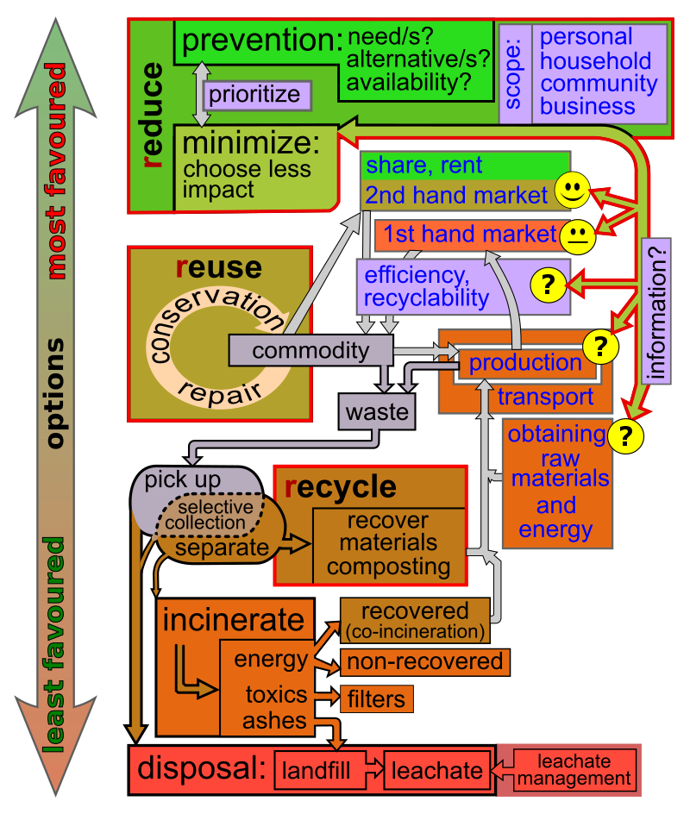
Waste Hierarchy
The waste hierarchy refers to the "3 Rs"
Reduce, Reuse and Recycle,
which classifies waste management strategies according to their desirability in terms of waste minimisation.
The waste hierarchy is the cornerstone of most waste minimisation strategies.
The aim of the waste hierarchy is to extract the maximum practical benefits from products and to generate the minimum amount of end waste.

Slide 12
Waste Hierarchy
The next step or preferred action is to seek alternative uses for the waste that has been generated i.e. by re-use.
The next is recycling which includes composting.
Following this step is material recovery and waste-to-energy.
The final action is disposal, in landfills or through incineration without energy recovery.
This last step is the final resort for waste which has not been prevented, diverted or recovered.
The waste hierarchy represents the progression of a product or material through the sequential stages of the pyramid of waste management.
The hierarchy represents the latter parts of the life-cycle for each product.

Slide 13
Life-Cycle of a Product
The life-cycle begins with design, then proceeds through manufacture, distribution, and primary use and then follows through the waste hierarchy's stages of reduce, reuse and recycle.
Each stage in the life-cycle offers opportunities for policy intervention, to rethink the need for the product, to redesign to minimize waste potential, to extend its use.
Product life-cycle analysis is a way to optimize the use of the world's limited resources by avoiding the unnecessary generation of waste.

Slide 14
Resource efficiency
Resource efficiency reflects the understanding that global economic growth and development can not be sustained at current production and consumption patterns.
Globally, humanity extracts more resources to produce goods than the planet can replenish.
Resource efficiency is the reduction of the environmental impact from the production and consumption of these goods, from final raw material extraction to the last use and disposal.

Slide 15
Polluter-pays Principle
The polluter-pays principle mandates that the polluting party pays for the impact on the environment. With respect to waste management, this generally refers to the requirement for a waste generator to pay for appropriate disposal of the unrecoverable material.

Slide 16
Disposal methods
Landfill
A landfill is a site for the disposal of waste materials by burial. Landfill is the oldest form of waste treatment, although the burial of the waste is modern; historically, refuse was simply left in piles or thrown into pits. Historically, landfills have been the most common method of organized waste disposal and remain so in many places around the world.
Incineration
Incineration is a disposal method in which solid organic wastes are subjected to combustion so as to convert them into residue and gaseous products. This method is useful for disposal of both municipal solid waste and solid residue from waste water treatment. This process reduces the volumes of solid waste by 80 to 95 percent. Incineration and other high temperature waste treatment systems are sometimes described as "thermal treatment". Incinerators convert waste materials into heat, gas, steam, and ash.

Slide 17
Recycling
Recycling is a resource recovery practice that refers to the collection and reuse of waste materials such as empty beverage containers. The materials from which the items are made can be reprocessed into new products.
Materials for recycling may be collected separately from general waste using dedicated bins and collection vehicles, a procedure called kerbside collection.
In some communities, the owner of the waste is required to separate the materials into different bins (e.g. for paper, plastics, metals) prior to its collection.
In other communities, all recyclable materials are placed in a single bin for collection, and the sorting is handled later at a central facility.
The latter method is known as "single-stream recycling.

Slide 18
Re-use
Biological reprocessing
Recoverable materials that are organic in nature, such as plant material, food scraps, and paper products, can be recovered through composting and digestion processes to decompose the organic matter. The resulting organic material is then recycled as mulch or compost for agricultural or landscaping purposes.
Energy recovery
Energy recovery from waste is the conversion of non-recyclable waste materials into usable heat, electricity, or fuel through a variety of processes, including combustion, gasification, pyrolyzation, anaerobic digestion, and landfill gas recovery.
This process is often called waste-to-energy. Energy recovery from waste is part of the non-hazardous waste management hierarchy.

Slide 19
Re-use
Pyrolysis
Pyrolysis is often used to convert many types of domestic and industrial residues into a recovered fuel. Different types of waste input (such as plant waste, food waste, tyres) placed in the pyrolysis process potentially yield an alternative to fossil fuels. Pyrolysis is a process of thermo-chemical decomposition of organic materials by heat in the absence of stoichiometric quantities of oxygen; the decomposition produces various hydrocarbon gases.
Resource recovery
Resource recovery is the systematic diversion of waste, which was intended for disposal, for a specific next use.[29] It is the processing of recyclables to extract or recover materials and resources, or convert to energy.[30] These activities are performed at a resource recovery facility.[30] Resource recovery is not only environmentally important, but it is also cost-effective.[31] It decreases the amount of waste for disposal, saves space in landfills, and conserves natural resources.

Slide 20
Re-use
Sustainability
The management of waste is a key component in a business' ability to maintain ISO14001 accreditation. The standard encourages companies to improve their environmental efficiencies each year by eliminating waste through resource recovery practices. One way to do this is by adopting resource recovery practices like recycling materials such as glass, food scraps, paper and cardboard, plastic bottles and metal. Recycled materials can often be sold to the construction industry. Many inorganic waste streams can be used to produce materials for construction. Concrete and bricks can be recycled as artificial gravel.

Slide 21
Liquid waste-management
Sewage sludge
Sewage sludge is produced by waste water treatment processes. Due to rapid urbanization, there has been an increase in municipal waste water that results 0.1–30.8 kg of sewage per population equivalent per year (kg/p.e/year).
Common disposal practices of sewage sludge are incineration, composting, and landfill.

Slide 22
Avoidance & reduction methods
Methods of avoidance include reuse of second-hand products, repairing broken items instead of buying new ones, designing products to be refillable or reusable (such as cotton instead of plastic shopping bags), encouraging consumers to avoid using disposable products (such as disposable cutlery), removing any food/liquid remains from cans and packaging, and designing products that use less material to achieve the same purpose (for example, light weighting of beverage cans).

Slide 23
Challenges in developing countries
Areas with developing economies often experience exhausted waste collection services and inadequately managed and uncontrolled dumpsites. The problems are worsening.
Problems with governance complicate the situation.
Waste management in these countries and cities is an ongoing challenge due to weak institutions, chronic under-resourcing and rapid urbanization.
All of these challenges, along with the lack of understanding of different factors that contribute to the hierarchy of waste management, affect the treatment of waste

Slide 24
Goals of waste management
Minimize waste quantity,
Reduce the amount of raw materials consumed,
Dispose of non-hazardous waste cost-effectively,
Dispose of hazardous waste with minimal risk to Human health and the environment.
Communities use a variety of methods to manage wastes depending on the type of waste involved. Methods used include land filling, incineration, and composting, with both upstream and downstream separation of usable materials for recycling.
There is also an increasing interest and awareness in the reuse of materials, as well as in source reduction through product redesign and efficient packaging.

Slide 25
THANK YOU

